Slide 1
Exception Handling in Web API
Sarita Lad
DATE

Slide 2
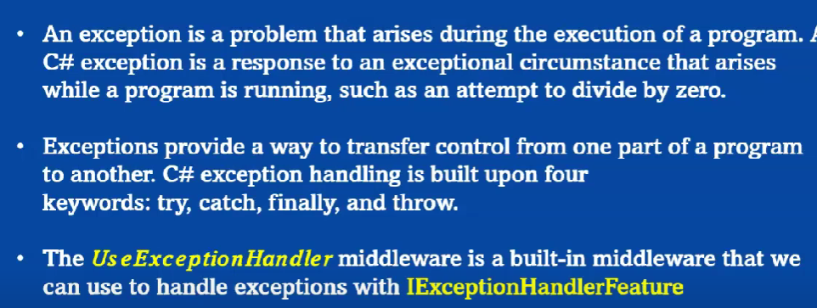

Slide 4
Thank You

